Slide 1
UCB - CS189 Introduction to Machine Learning Fall 2015 Lecture 14: Mixture models
Isabelle Guyon
ChaLearn

Slide 2
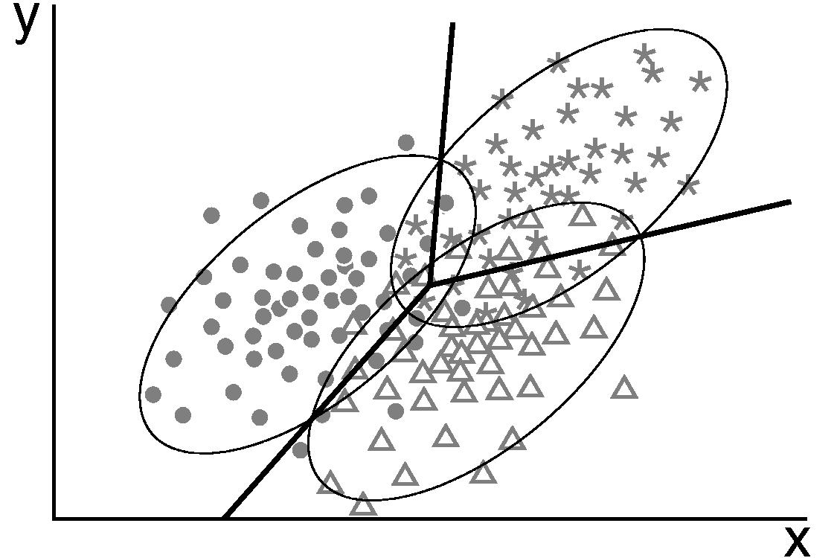
Come to my office hours… Wed 1:30-3:30 Soda 329
Last time: LDA

Slide 3
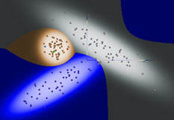
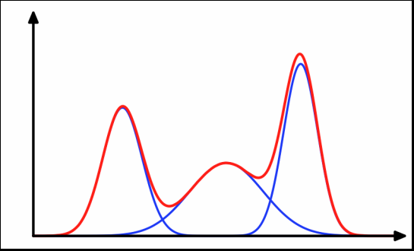
Come to my office hours… Wed 1:30-3:30 Soda 329
Today: Mixture models

Slide 4
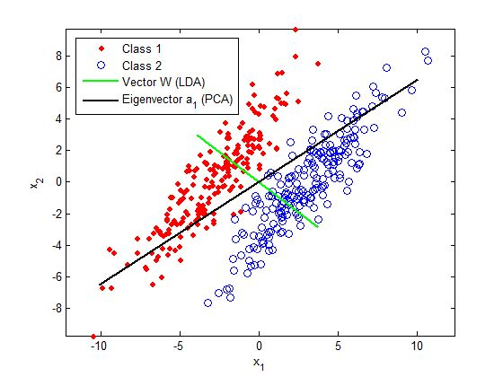
Covariance matrix Σ = X^{T}X
Review
x₂
u₂
u₁
s₁
s₂
x₁
Source: www.intechopen.com
Σ = X^{T}X covariance matrix (centered data) σ_{ij}=(1/N)Σ_{k=1:N} (x_{i}^{k}- μ_{i})(x_{j}^{k}- μ_{xj})
Σ = US²U^{T} U = [u_{i} eigen vectors], S = [s_{i} diagonal singular values]
U^{T}U = I

Slide 5
N
X=[x^{k}_{i}]
data matrix
feature dim(N, 1)
feature dim(N, 1)
x_{i}
x_{j}
N samples
x^{k}
sample dim(1, d)
d
X^{T}
d features
Σ = X^{T}X
dim(d,d)

Slide 6

Σ⁻¹ for BIG data
X^{T}X dim(d,d)
XX^{T} dim(N,N)
which one do I rather invert?
Singular value decomposition:
X=VSU^{T}, with U^{T}U=1 and V^{T}V=1
S diagonal dim(r, r): singular values, r = rank(X)≤min(d,N)
X^{T}X=US²U^{T} and XX^{T}=VS²V^{T} dim(U)=(d, r) dim(V)=(N, r)
cheap Ξ = XU, Σ^{1/2} = USU^{T}, Σ⁻¹ = US⁻²U^{T}, etc.
r is small + keep only largest singular values.
Kernel trick:
d>>N → XX^{T} = VS²V^{T} XX^{T} → K (kernel trick)
Instead of Ξ = XU use Ξ = VS, much cheaper!
Ξ_{new} = X_{new} U? X=VSU^{T} so U = X^{T}VS⁻¹
Ξ_{new} = X_{new} X^{T}VS⁻¹ X_{new} X^{T}→ [k(x^{h}, x^{k})] (kernel trick)

Slide 7
Rotation in principal axes
Review
u₂
u₁
s₁
s₂
Σ = X^{T}X = US²U^{T}
Ξ = X U
(N, r) (N, d)(d, r) Ξ^{T}Ξ = S²
U = [u_{i} eigen vectors]
PCA consists in keeping only the axes with largest eigen values

Slide 8

Benefits of rotation in principal axes
?
Review
Σ = X^{T}X = US²U^{T}
Ξ = X U dim(N, r) Ξ^{T}Ξ = S²
U = [u_{i} eigen vectors]

Slide 9
Benefits of rotation in principal axes
?
Review
Σ = X^{T}X = US²U^{T}
Ξ = X U dim(N, r) Ξ^{T}Ξ = S²
U = [u_{i} eigen vectors]
In the new Ξ-space the covariance matrix Ξ^{T}Ξ is diagonal.
Inverting a diagonal matrix (or taking its square root) is trivial.

Slide 10
Benefits of rotation in principal axes
?
Review
Σ = X^{T}X = US²U^{T}
Ξ = X U dim(N, r) Ξ^{T}Ξ = S²
U = [u_{i} eigen vectors]
In the new Ξ-space the covariance matrix Ξ^{T}Ξ is diagonal.
Inverting a diagonal matrix (or taking its square root) is trivial.
Application to ridge regression:
f(x) = x w^{T}
w^{T} = (X^{T} X +λI)⁻¹ X^{T} y λ>0
(d,1) (d,N)(N,d) (d,d) (d,N) (N,1)
In the rotated space:
f(x) = ξ ω^{T} ξ = x U S²+λI =
ω^{T} = (S²+λI)⁻¹ Ξ^{T} y
w^{T} = U (S²+λI)⁻¹ U^{T} X^{T} y
S₁²+λ
S₂²+λ
∴∴∴
S_{d}²+λ

Slide 11
How to transform new samples
Review
Σ = X^{T}X = US²U^{T}
Ξ = X U dim(N, r) Ξ^{T}Ξ = S²
(N, r) (N, d)(d, r)
U = [u_{i} eigen vectors]
Now we get a new sample x_{new} not in the training set.
φ_{new} = x_{new} U
Likewise on a test matrix X’ of dim(N’, d)
Ξ’ = X’ U dim(N’, r)
(N’, r) (N’, d)(d, r)
Do NOT compute U on all the data [X ; X’] and do [X ; X’]U.

Slide 12
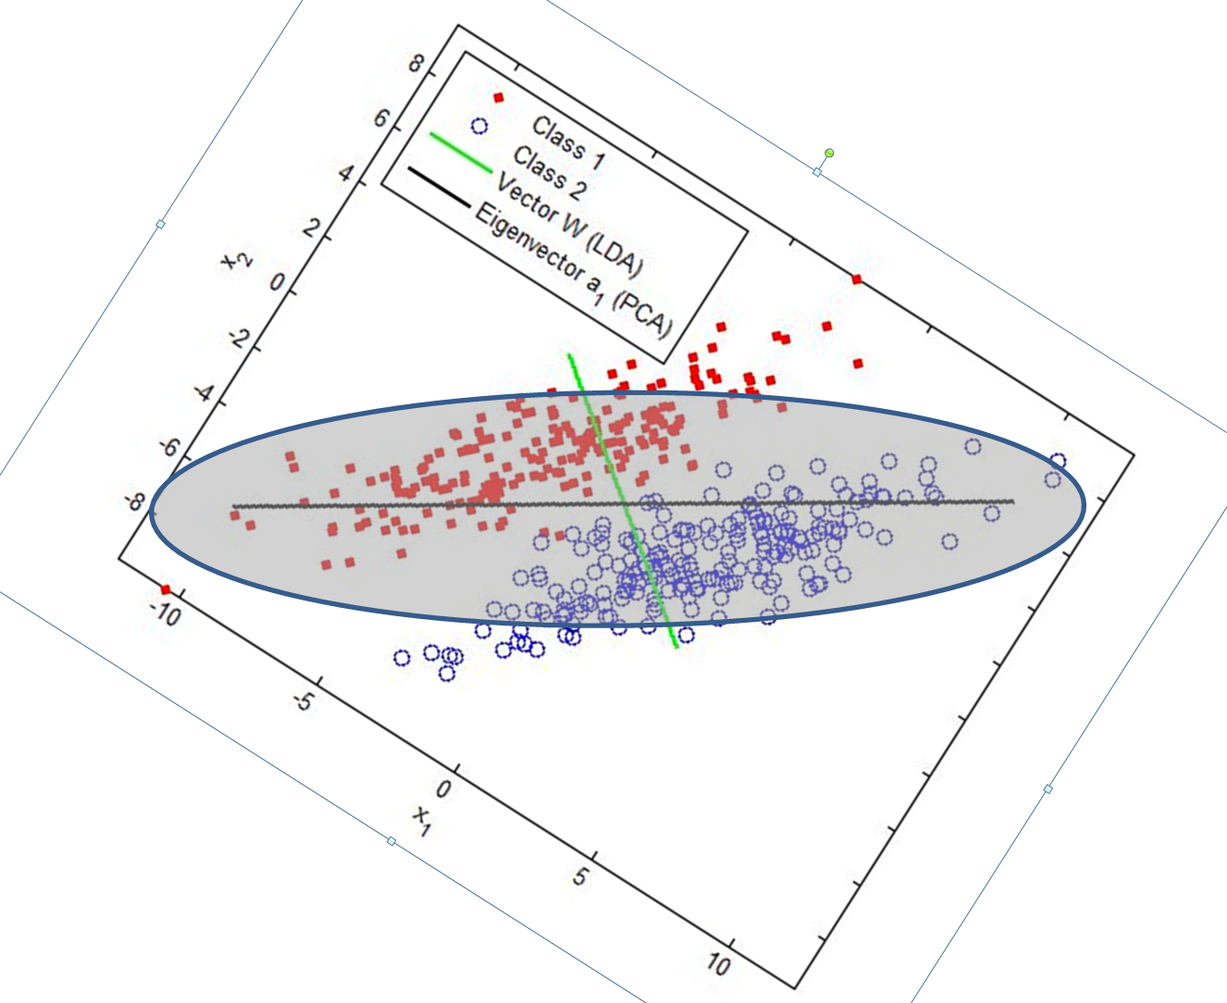
Rotation and scaling (whitening)
Review
u₂
1
u₁
1
Σ = X^{T}X = US²U^{T}
Ξ = X Σ^{-1/2} Ξ^{T}Ξ = Ι
(N, r) (N,d)(d, r)
Σ^{1/2 =} USU^{T}

Slide 13
Benefits of whitening
?
Review
Σ = X^{T}X = US²U^{T}
Ξ = X Σ^{-1/2} dim(N, r) Ξ^{T}Ξ = Ι
Σ^{1/2 =} USU^{T}
Same as rotating in principal axes +
The weights of any linear method in Ξ-space are on the same scale.

Slide 14
Sphering
Review
x₂
σ₂
σ₁
x₁
Source: www.intechopen.com
Hypothesize no covariance (even if there is some).
Rescale all axes by the standard deviation or the samples.

Slide 15

Sphering
Review
x₂
1
1
x₁
Benefit: The weights of any linear method are on the same scale.
But we still have some covariance between features…

Slide 16
LDA and PCA difference
?
Review
Source: www.intechopen.com
Apply whitening in both case to get Ξ = X Σ^{-1/2}
PCA: Σ is the TOTAL covariance matrix.
LDA: Σ is the POOLED WITHIN CLASS covariance matrix.

Slide 17
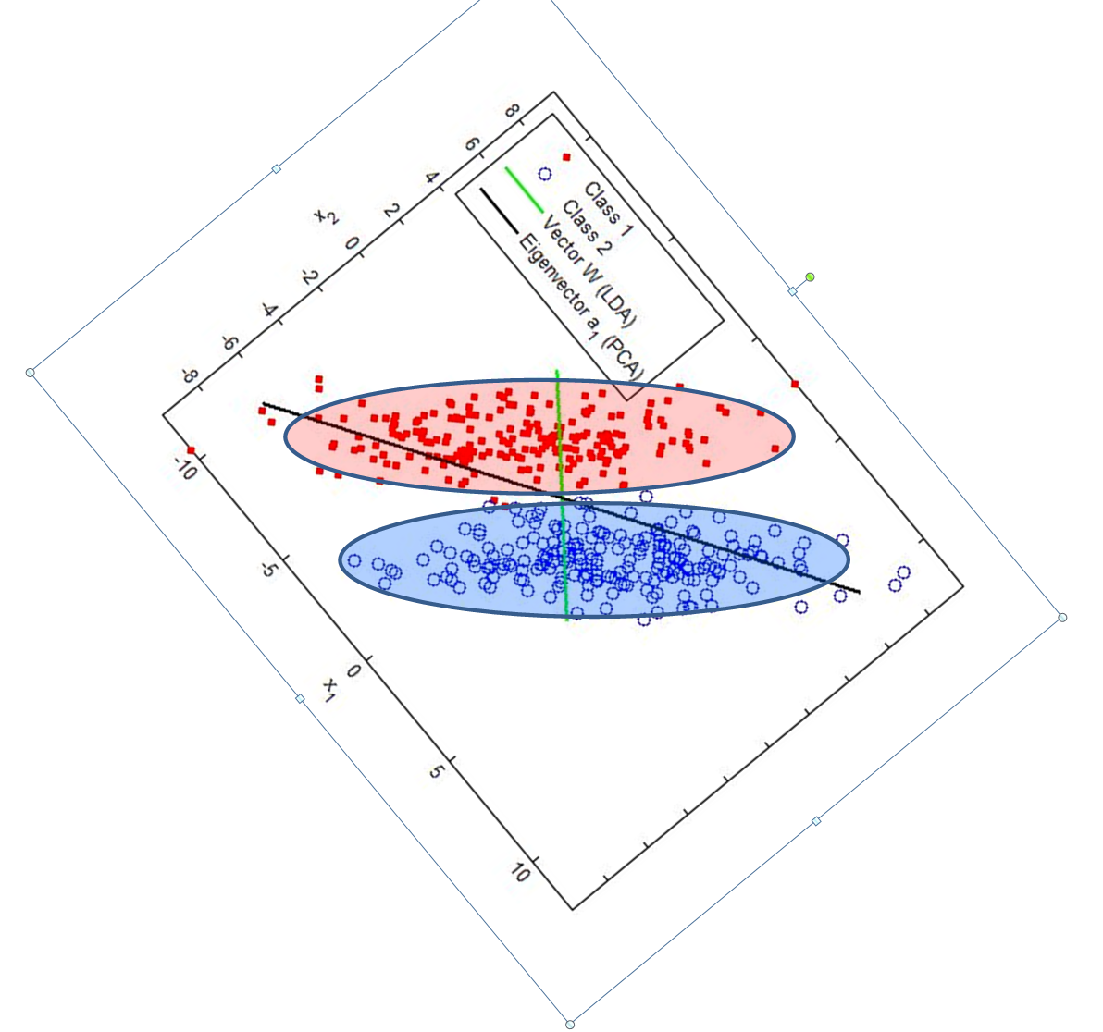
Rotate and scale in LDA directions
Review
Now we can use the plain centroid method.
Σ = X^{T}X = US²U^{T} 1) X is centered
Ξ = X Σ^{-1/2} Ξ^{T}Ξ = Ι 2) Σ is the POOLED within
Σ^{1/2 =} USU^{T} class covariance

Slide 18
Rotate and scale in PCA directions
Review
u₂
1
u₁
1
Σ = X^{T}X = US²U^{T} 1) X is centered
Ξ = X Σ^{-1/2} Ξ^{T}Ξ = Ι 2) Σ is the TOTAL overall
Σ^{1/2 =} USU^{T} covariance

Slide 19
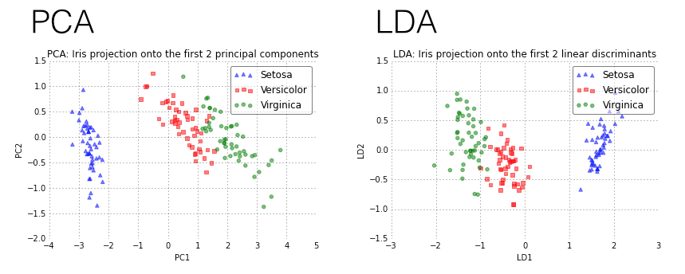
LDA and PCA visualization
Review
http://sebastianraschka.com/Images_old/2014_intro_supervised_learning/iris_pca_lda.png

Slide 20
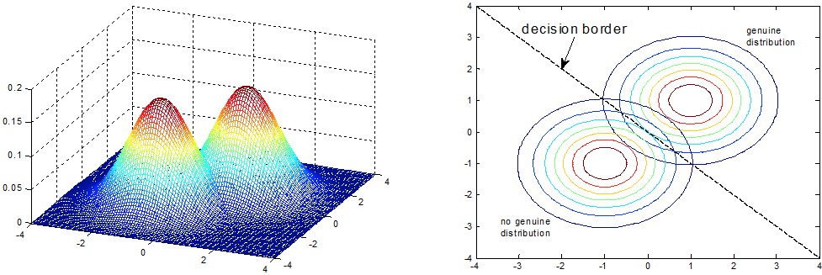
Gaussian classifier ŷ =argmax_{y} P(Y=y|X=x) ~ P(Y=y) P(X=x|Y=y) ~ P(Y=y) exp(-ǁx-μ^{[y]}ǁ²/2σ²)
Review
x₂
f(x) =0
μ^{[1]}
y
μ^{[0]}
Source: http://www.intechopen.com
w
x₁
f(x) = (μ^{[1]} – μ^{[0]}) • x + b b = (μ^{[0]2} – μ^{[1]2})/2+log(N₁/N₀)
f(x) = (μ^{[1]}./σ^{[1]2} – μ^{[0]} ./σ^{[0]2}) • x + b b = [(μ^{[0]}./σ^{[0]})² – (μ^{[1]}./σ^{[1]})²)/2+log(N₁/N₀)
f(x) = Σ⁻¹(μ^{[1]}– μ^{[0]}) • x + b b = [(μ^{[0]T}Σ⁻¹μ^{[0]} – μ^{[1]T}Σ⁻¹μ^{[1]})/2+log(N₁/N₀)

Slide 21

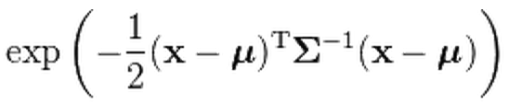
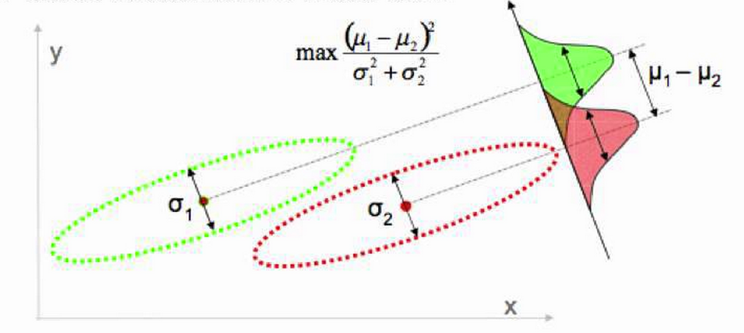
LDA is a “glorified” Gaussian classifier
Review
^{[y]}
^{[y]}
T
P(X=x|Y=y) ~
(1, d) (d,d) (d, 1)
(μ^{[1]}– μ^{[0]})²
x₂
s²
μ^{[1]}– μ^{[0]}
s
s
x₁
w
Source: Victor Lavrenko
f(x) = Σ⁻¹(μ^{[1]}– μ^{[0]}) • x + b b = [(μ^{[0]T}Σ⁻¹μ^{[0]} – μ^{[1]T}Σ⁻¹μ^{[1]})/2+log(N₁/N₀)

Slide 22
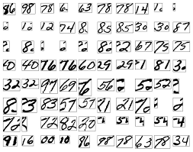

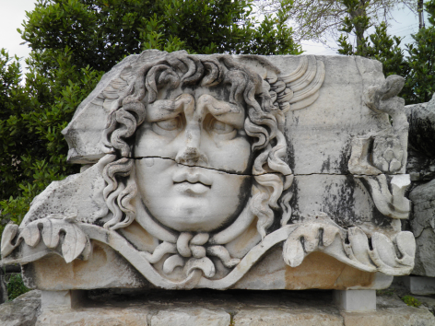


Which assumption is right for you? P(X, Y) = P(X)P(Y|X) = P(Y)P(X|Y)
P(X)
5
P(Y)
P(X|Y)
P(Y|X)
96 98 78 6 63 79…

Slide 23
It does not really matter! Bias vs. variance tradeoff
f trained on a training set D of size m (m fixed)
For the square loss:
E_{D}[f(x)-y]² = [E_{D}f(x)-y]² + E_{D}[f(x)-E_{D}f(x)]²
Expected value of the loss over datasets D of the same size
Bias²
Variance
f(x)
Variance
E_{D}f(x)
Bias²
y target
Notes:
E_{D}f(x,D) is the aggregated learning machine

Slide 24
Violated assumption (1): Gaussianity Centroid vs. SVM
x₂
y
x₁
Noisy data or lack of training data: Even if the class clusters have a tailed distribution, you might be better off making Gaussian assumptions.

Slide 25
Violated assumption (2): wrong data generating “direction”
x₂
y
f*(x)=0
x₁
“Wrong” data generating assumption: P(Y=y) then P(X=x|Y=y)
In reality: P(X=x) then P(Y=y|X=x)=1 if f*(x)>0, or 0 if f*(x)<0.

Slide 26
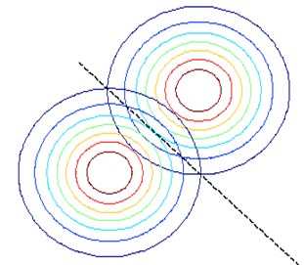
Violated assumption (2): P(X=x|Y=y) not Gaussian
x₂
y
f*(x)=0
x₁
“Wrong” data generating assumption: P(Y=y) then P(X=x|Y=y)
In reality: P(X=x) then P(Y=y|X=x)=1 if f*(x)>0, or 0 if f*(x)<0.
The Gaussian model assumptions are violated.

Slide 27
Would the centroid method still be OK? Let’s compare with the regression solution…
x₂
y
f(x)=0
f(x)=1
f(x)=-1
x₁
Regression = discriminative classifier:
“Correct” data generating assumption: P(X=x) then P(Y=y|X=x)
but “wrong” loss function (f(x) – y)² for classification? (y=±1)

Slide 28
Explanation: Regression for classification ≡ LDA / Fisher linear discriminant
x₂
y
f(x)=0
LDA:
w= Σ⁻¹(μ^{[1]}– μ^{[0]})
RIDGE REGRESSION:
w= Σ⁻¹X^{T}y
LDA:
w= Σ⁻¹(μ^{[1]}– μ^{[0]})
REGRESSION:
w= Σ⁻¹X^{T}y
Σ⁻¹
f(x)=1
Σ⁻¹
Regularized Σ⁻¹
Σ⁻¹ ⁼ (X^{T} X +λI)⁻¹
f(x)=-1
x₁
If:
covariance matrix ≡ pooled within class covariance, and
y ∈ {+1/N₁, -1/N₀}.

Slide 29
What about logistic regression?
x
1
P(Y=y|X=x)=
1+ e^{-yf(x)}
P(Y=1|X=x)=0.5
f(x)=0
P(Y=1|X=x)=1
y
P(Y=1|X=x)=0
x₂
x₁
Logistic regression = discriminative classifier:
“Correct” data generating assumption: P(X=x) then P(Y=y|X=x)
“Correct” loss function -log P(Y=y|X=x)= log(1+ e^{-yf(x)}) (y=±1)

Slide 30

The Gaussian “posterior” is “logistic”
x
p=P(Y=1|X=x)=1
f(x) = Σ⁻¹(μ^{[1]}– μ^{[0]}) • x + b = 0
P(Y=1|X=x)=0
The sigmoid comes from the logistic link:
P(Y=1|X=x)
P(Y=-1|X=x)
log((p/(1-p)) = f(x)
p = 1/(1+ e^{-f(x)})
x₂
log
= f(x)
y
x₁
^{[y]}
^{[y]}
T
Generative model: P(Y=y) then P(X=x|Y=y)~
We have seen that the log odds-ratio is a linear model.
So… The posterior P(Y=1|X=x) of the Gaussian model is logistic.

Slide 31
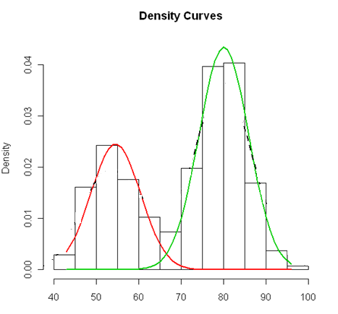
The posterior P(Y=1|X=x) of the Gaussian model is logistic
P(Y=1|X=x) =
P(Y=1) P(X=x|Y=1)
P(X=x)
P(Y=1) P(X=x|Y=1)
P(Y=1) P(X=x|Y=1)
P(X=x) = Σ_{y} P(Y=y) P(X=x|Y=y)
x

Slide 32

But the logistic model does not make any Gaussian assumption!
1
P(Y=1|X=x)=
1+ e^{-f(x)}
1
In logistic regression, only the marginal examples significantly contribute to determining the position and slope of the sigmoid, hence the posterior probability.
Logistic loss:
log(1+ e^{-yf(x)})
Well classified
with large (1-p)
Well classified
With large p
Marginal
0
x

Slide 33
The Gaussian model posterior estimation uses the examples
1
P(Y=1|X=x)=
1+ e^{-f(x)}
μ^{[1]}
f(x) = (μ^{[1]} – μ^{[0]}) • x + b
μ^{[0]}
x

Slide 34
Do we want to bother with LDA?
My own cookbook:
Preprocessing:
Pattern normalization: x^{k} ← x^{k} / ǁx^{k}ǁ (optional)
Feature centering: x_{i} ← x_{i} – μ_{i}
Singular value decomposition: X=VSU^{T}
U^{T}U=1, V^{T}V=1, S diagonal dim(r, r), r =rank(X)≤min(d,N)
Visualize data is 2 dim (top 2 s values) Ξ = X [u¹, u²]
- Further preprocess (e.g. non-linear scaling) (N, d) (d,2)
- Eventually replace Σ by pooled Σ
- Reduce space dimension with PCA or LDA Ξ = X [u¹, u²,.. u^{max}]
2) Linear methods:
Centroid (with targets y ∈ {+1/N₁, -1/N₀} or y=±1)
Soft margin SVM (~ ridge regression for large λ)
Post-fit SVM output to sigmoid (skip logistic regression)
3) Non-linear methods

Slide 35




Double random process
P(Y)
5
5
5
P(Y)
One style
P(X|Y)
P(X|Y)
Several styles

Slide 36
Multiple clusters per class
x₂
y
x₁

Slide 37
Mixture models
P(Y=1|X=x) ~
likelihood prior sum over different styles
P(X=x|Y=y) P(Y=y) = Σ_{k} P(X=x, S=s_{k}|Y=y) P(Y=y)
= Σ_{k} P(X=x|S=s_{k}, Y=y) P(S=s_{k}|Y=y) P(Y=y)
f(x) = P(Y=1|X=x) - P(Y=-1|X=x)
~ Σ_{k=1:Nc} α_{k} exp(-ǁx-μ_{k}ǁ²/2σ²) + b
~ exp(-ǁx-μ_{k}ǁ²/2σ²)
∼ α_{k}

Slide 38
RBF network RBF = radial basis function
x₁
k(μ¹,x)
α₁
x₂
k(μ²,x)
α₂
Σ
α_{N}
x_{n}
k(μ^{NC},x)
b
f(x) = Σ_{k} α_{k} k(μ^{k}, x) + b
1
k(. ,. ) is a similarity measure or “kernel”.

Slide 39
Parameter estimation
f(x) = Σ_{k=1:Nc} α_{k} k(μ^{k}, x) + b
k(μ^{k}, x) = exp(-ǁx-μ_{k}ǁ²/2σ²) Gaussian kernel
Parameters:
Nc = number of clusters
μ_{k}= cluster centers
α_{k} = cluster weights
σ = kernel width
Simple way:
Fix σ.
Fix Nc and take Nc/2 in each class.
In each class run k-means clustering to get the cluster centers μ_{k}.
Treat f(x) as a model linear in its parameters and fit the α_{k} by gradient descent.
Optimize σ and Nc by cross-validation.

Slide 40
Or, yet simpler: Parzen windows
f(x) = Σ_{k=1:N} y_{k} k(x^{k}, x) + b
k(x^{k}, x) = exp(-ǁx-x_{k}ǁ²/2σ²) Gaussian kernel
Parameters:
Nc = number of clusters
μ_{k}= cluster centers
α_{k} = cluster weights
σ = kernel width
Simpler way:
There is one “cluster” per example (Nc = N, μ_{k}=x^{k} ).
The α_{k} are also fixed: α_{k} = y_{k}
Optimize σ by cross-validation.

Slide 41

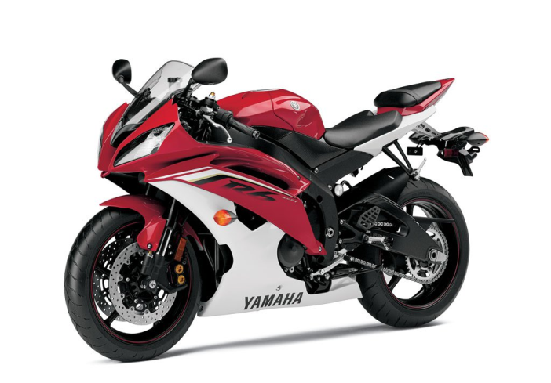
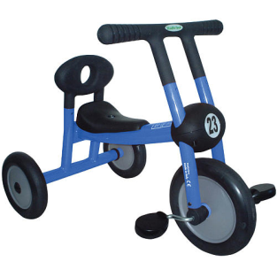
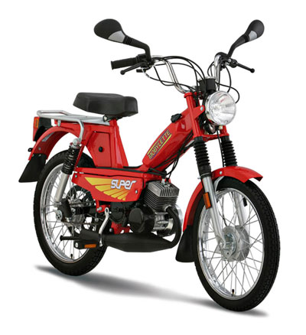
Generative models
You are here
Mixture models
LDA
Gaussian
processes
Naïve Bayes

Slide 42
Summary
We are trying to make sense of the models we are working with from a data generating process point of view. Useful for gaining insight, and potentially gaining performance advantages (by injecting “prior knowledge”):
Visualization allows us to evaluate our hypotheses.
Even if the hypotheses are wrong, we may get good results if the data are noisy or if we have few training samples, because of the “bias/variance” tradeoff.
SVM and logistic regression do not make data generating assumptions. But, ridge regression applied to classification problems is similar to LDA.
Gaussian mixtures: What if the single cluster per class hypothesis is violated? We can introduce multiple clusters per class; this is the idea of Gaussian mixtures and several “Radial Basis Function” (RBF) algorithms. This bridges the gap with kernel methods.

Slide 43
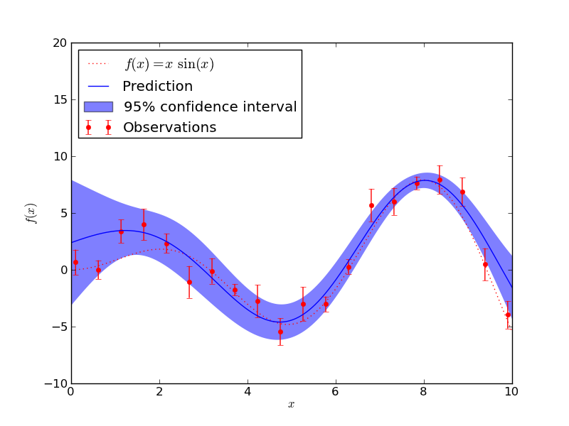
Come to my office hours… Wed 1:30-3:30 Soda 329
Next time: Gaussian processes

